Slide 1
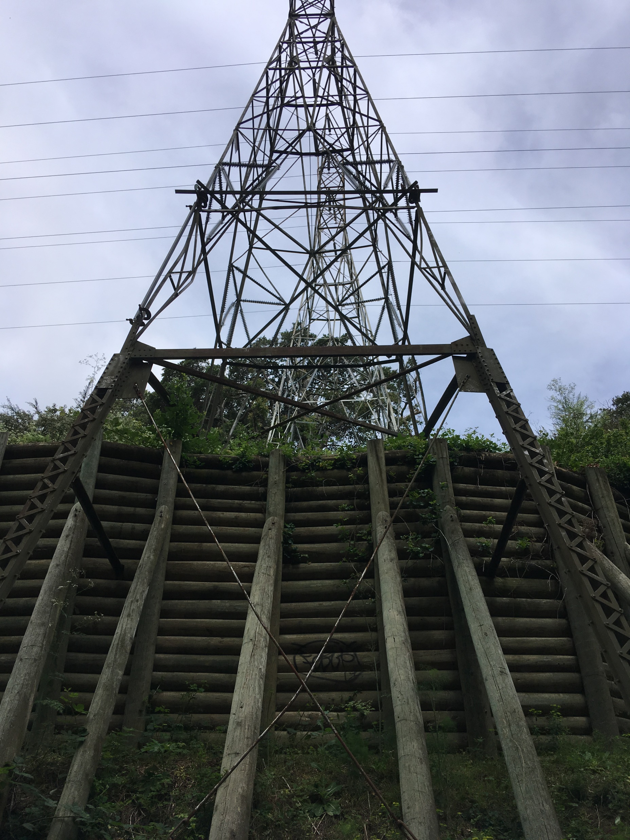
A Tale of Two Towers
A Transformation On The Montclair Railroad Trail
www.MontclairRRTrail.org
State of the Watershed 2021

Slide 2
The east meadow, our first large-scale restoration site on the Montclair RR Trail, in 2010.
Notes:
Friends of Montclair RR Trail chose the east meadow for our first restoration project in 2010. Great potential for an attractive spot

Slide 3
The east meadow had beautiful native oaks & elderberry – but was overgrown with Italian thistle, French broom, Himalayan blackberry, & feral grasses

Slide 4
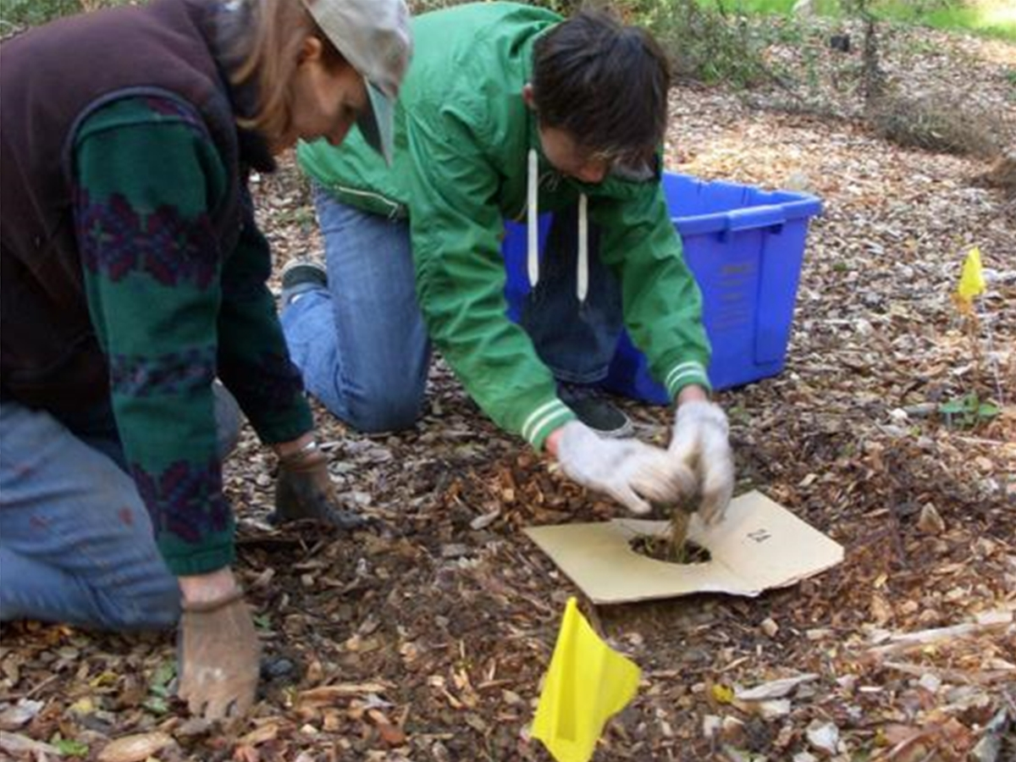
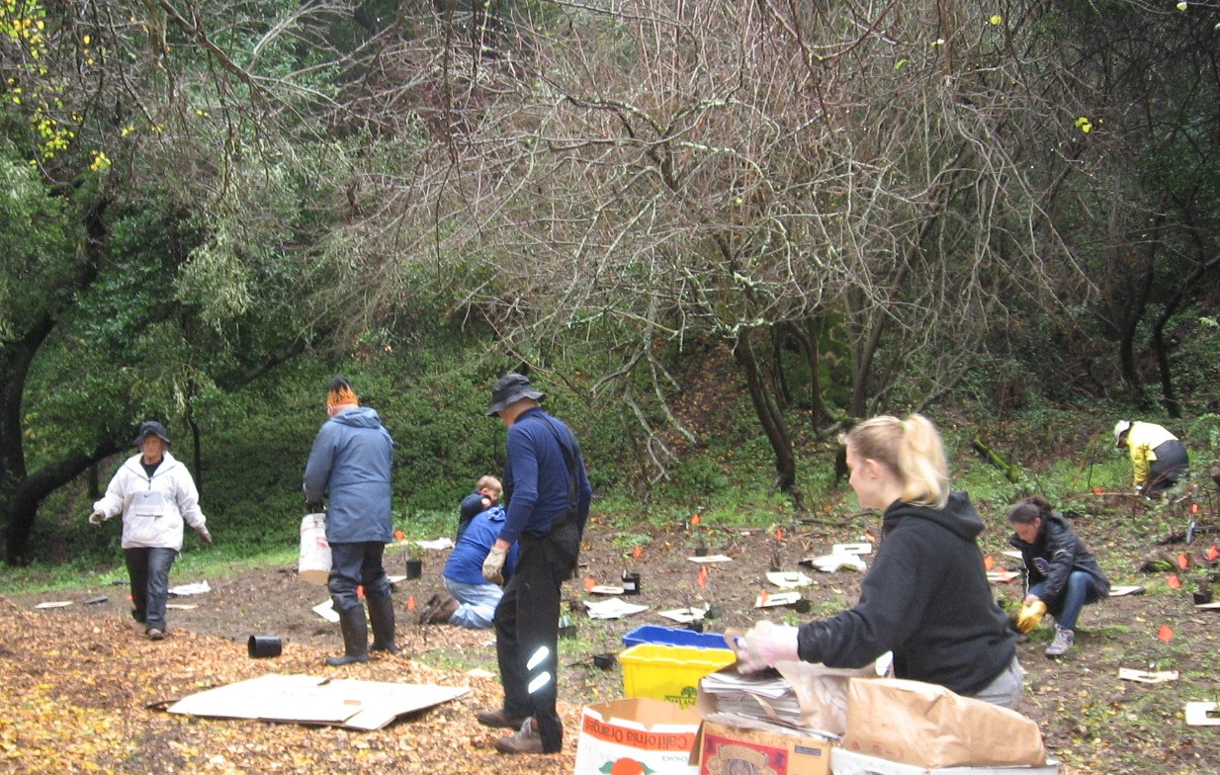
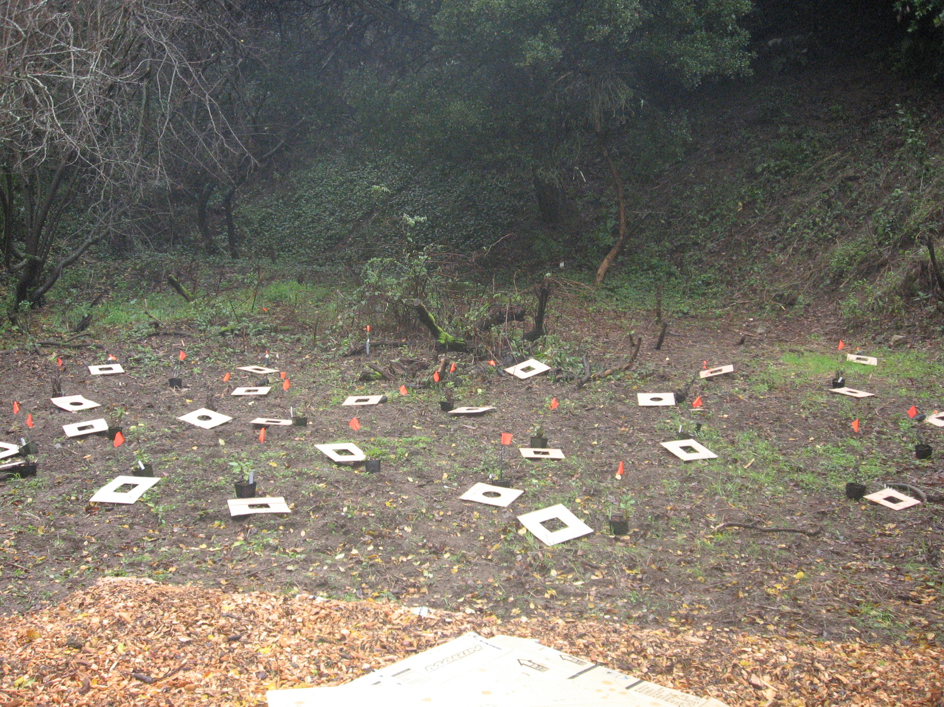
Our first winter solstice volunteer planting event, in 2010!
Plants donated by Friends of Sausal Creek Native Nursery

Slide 5
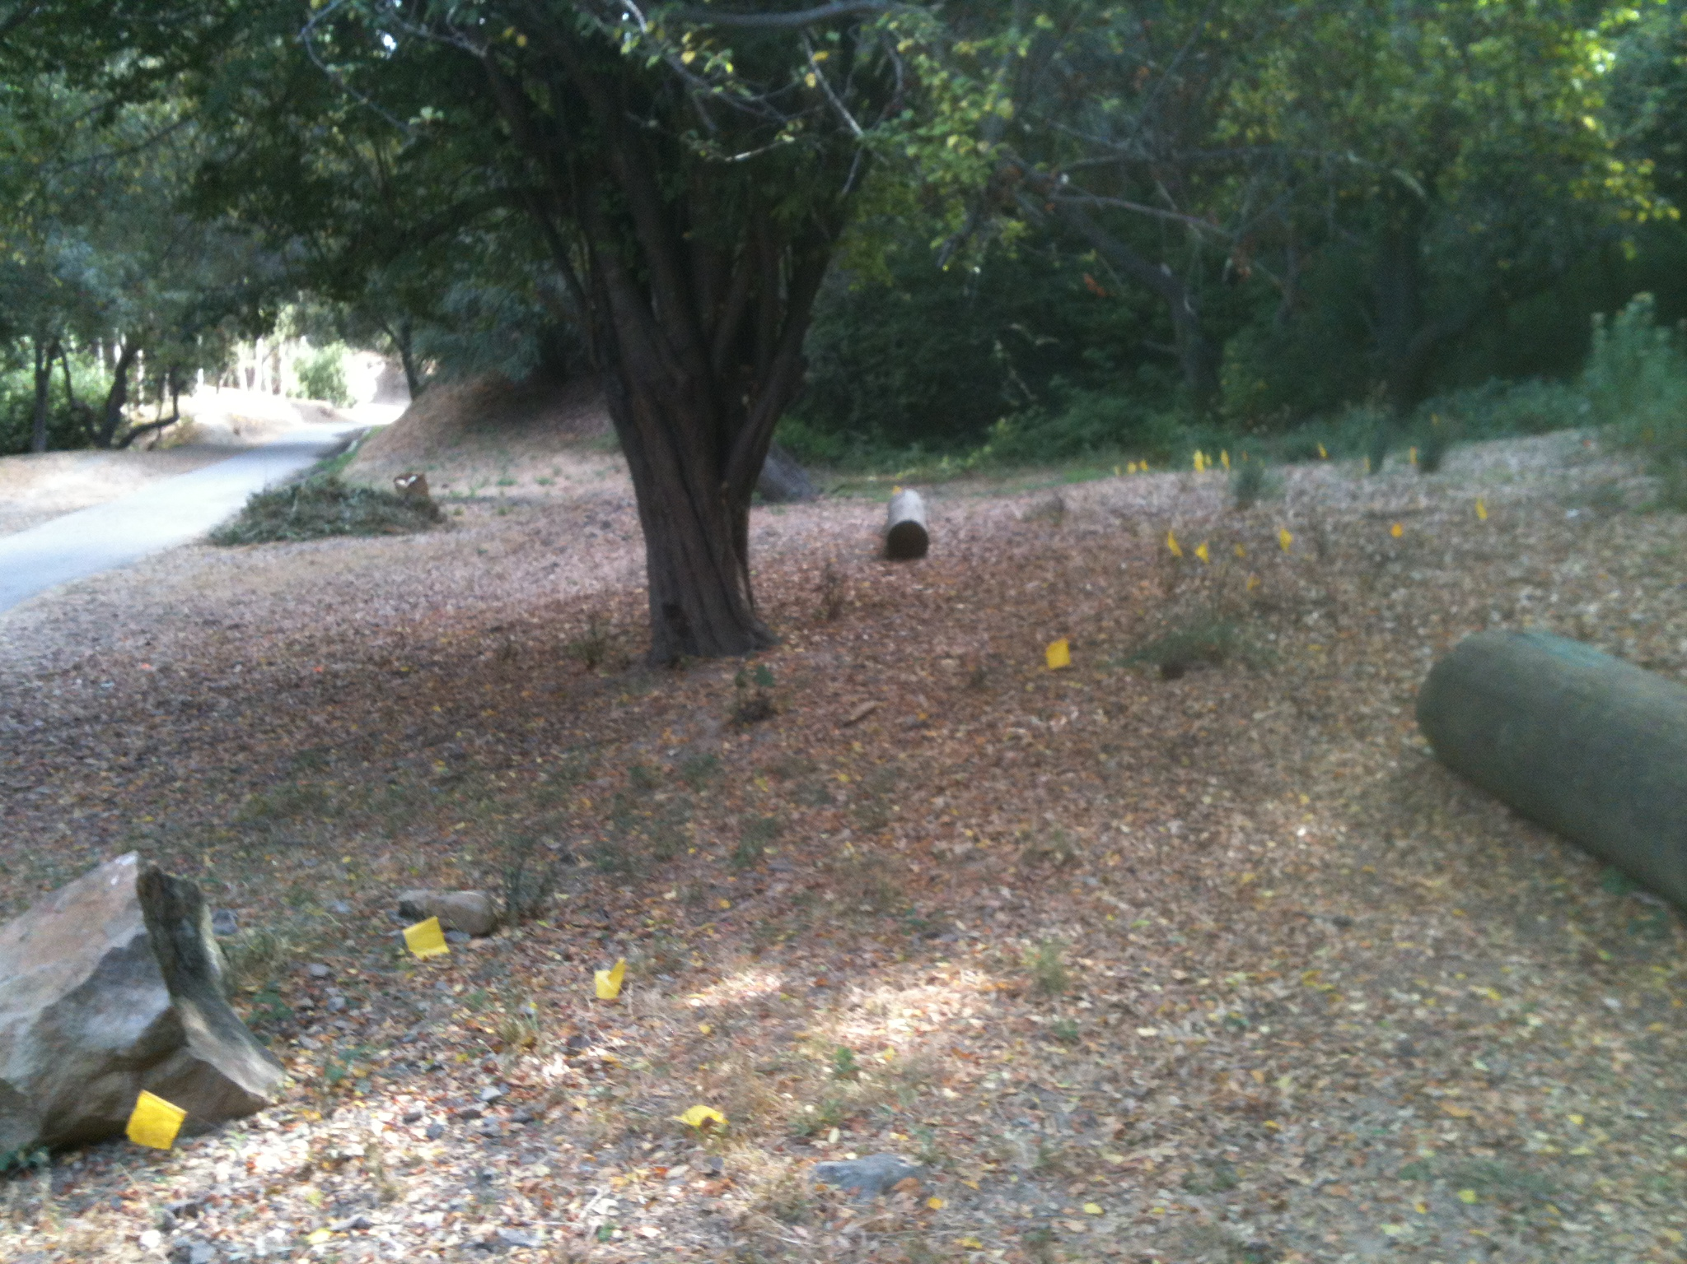
The east meadow plants grew over the years…

Slide 6
And the east meadow became a restful place for trail users…

Slide 7
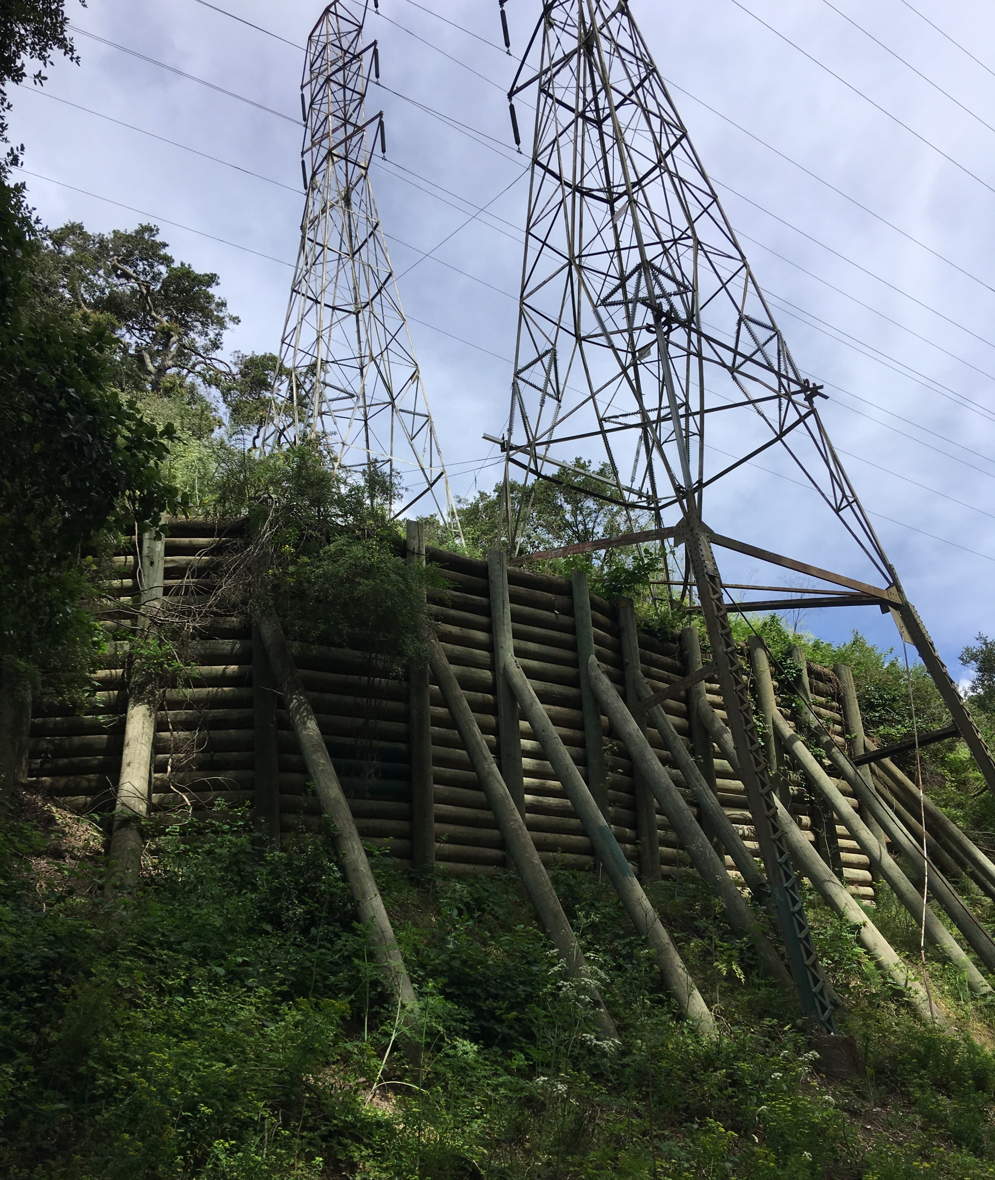
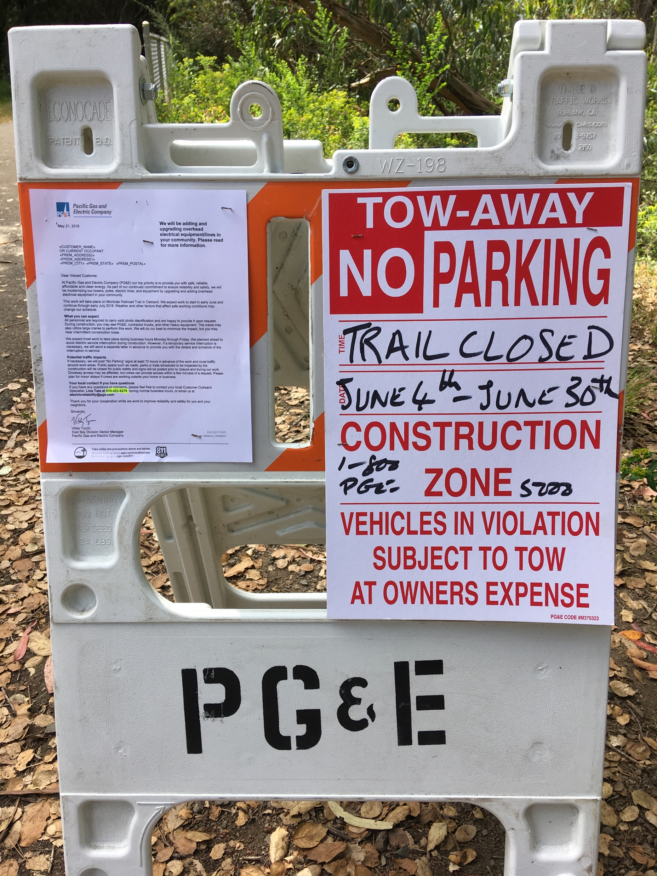
…but the hillside was shifting under the PG&E electrical towers. Replacement towers had to be built in the east meadow area.
Negotiations with PG&E were a success!
New towers should be less intrusive with a cleaner design & smaller footprint than the original towers.
Damaged areas should be restored, using plants native to the Sausal Creek watershed.
Preserve as many trees as possible.
Results need to match the welcome, tranquil setting we had established.

Slide 8
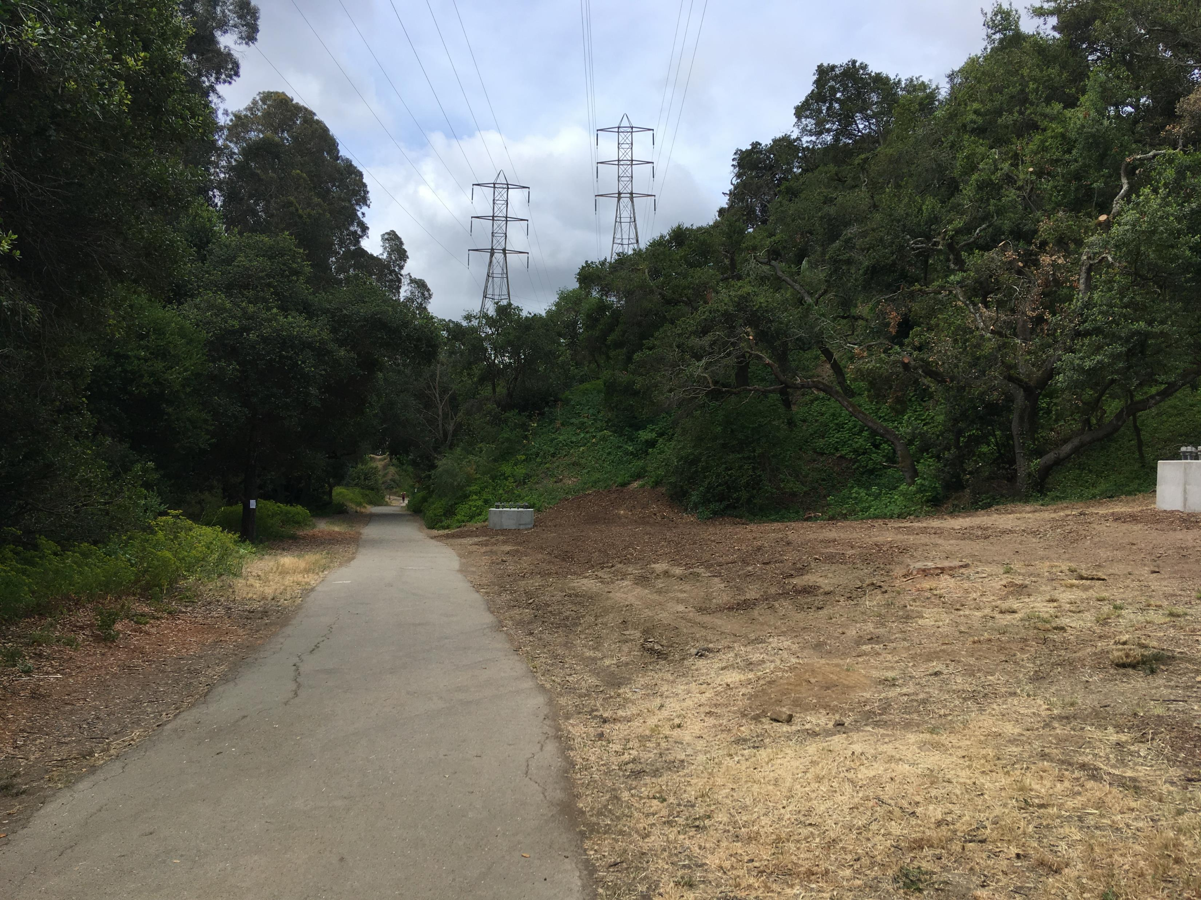
For equipment & construction, large swaths of the east meadow were cleared in 2018.

Slide 9
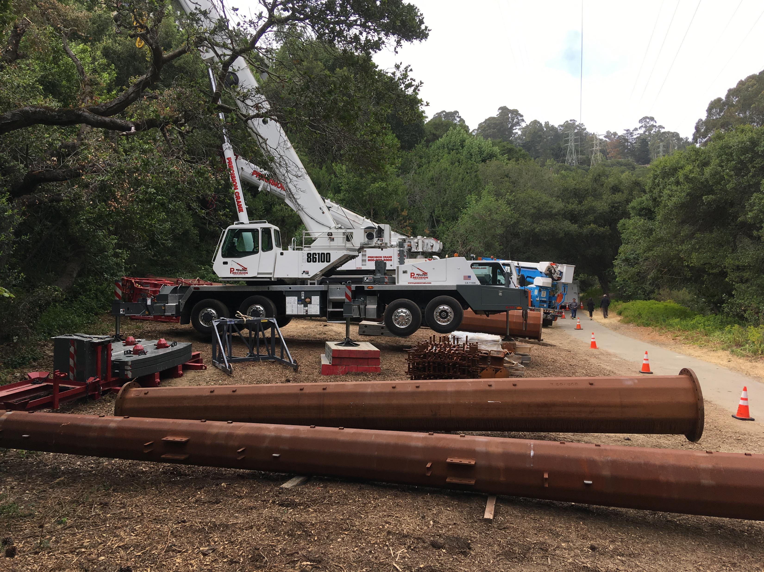
Once cleared, the construction project began. It was massive!

Slide 10
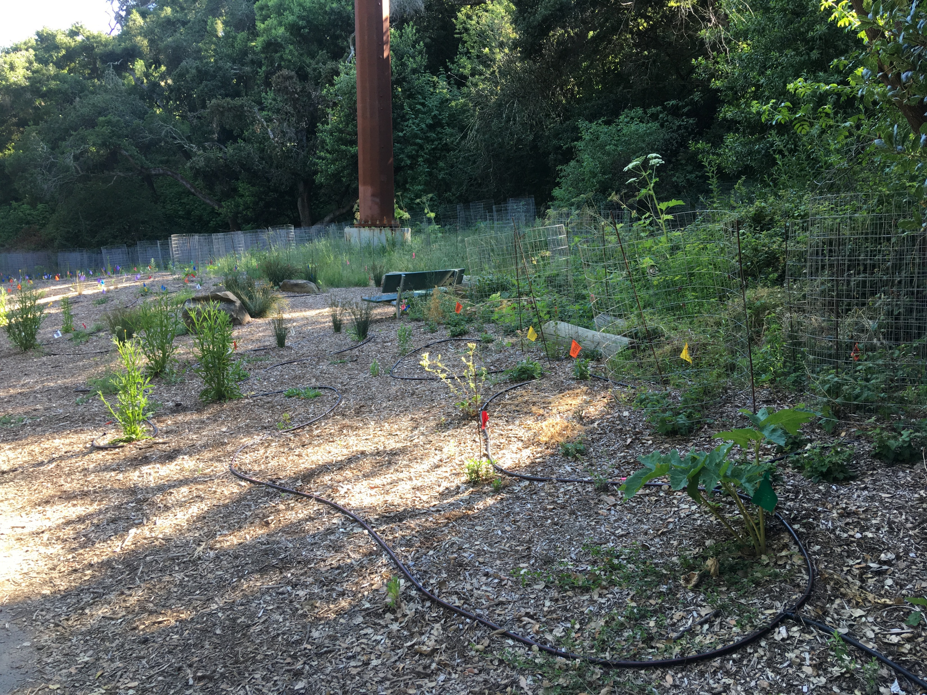
After construction, restoration began. PG&E committed to irrigating and maintaining the east meadow for 3 years. Planting started winter 2018.
Plant propagation and installation was by Ecological Concerns Inc. & Central Coast Wilds

Slide 11
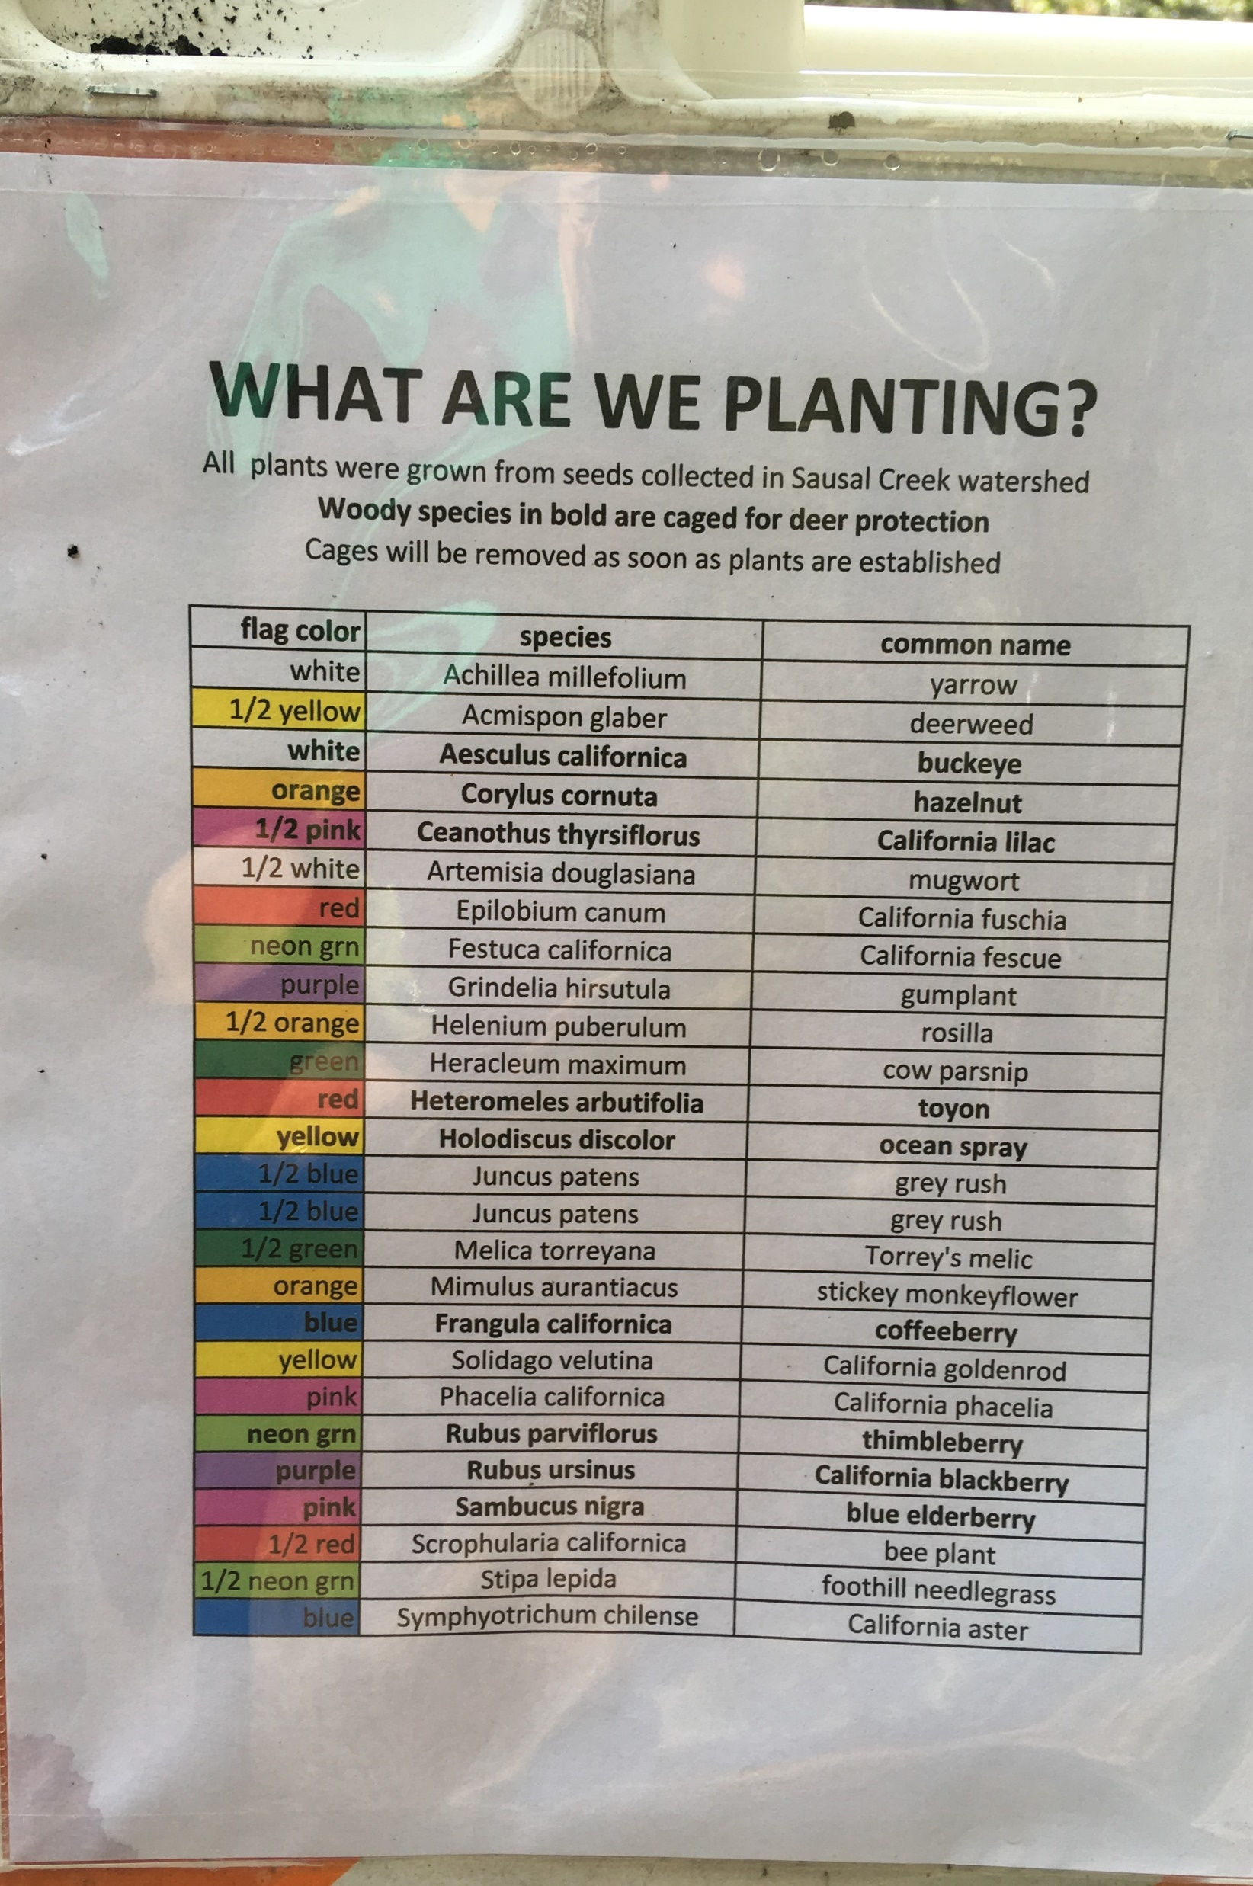
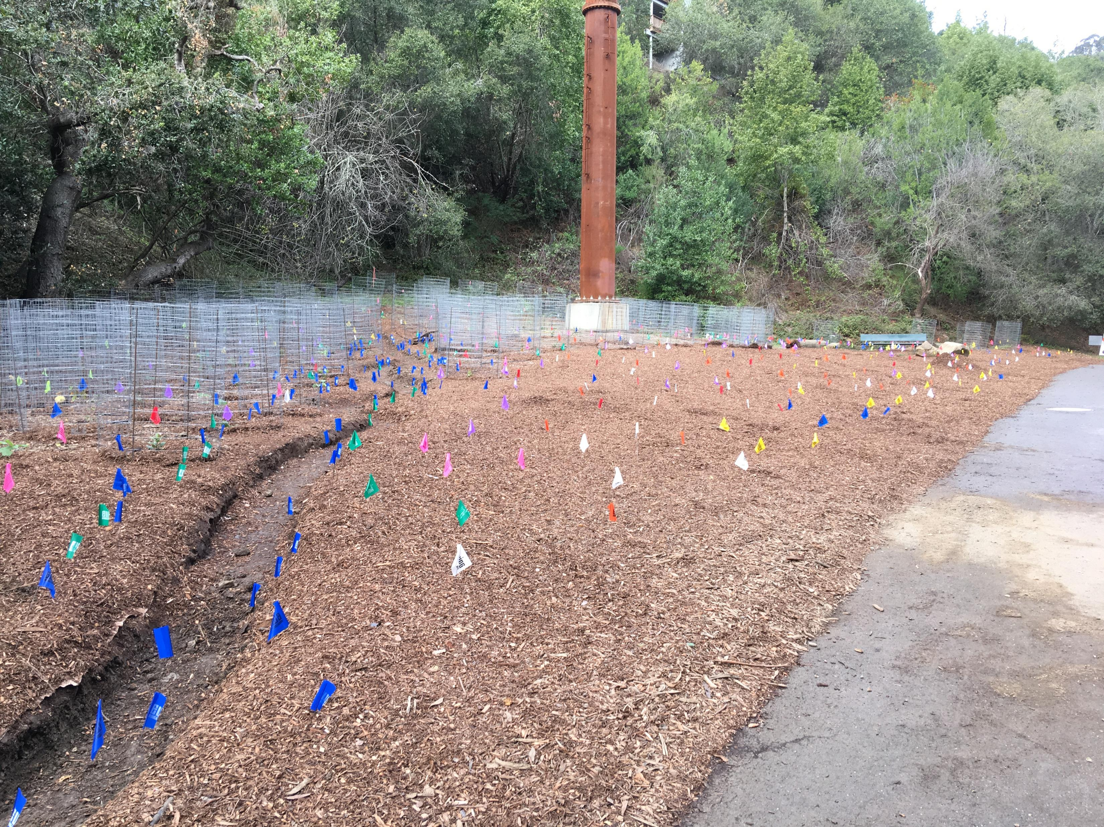
Native plant seeds were collected* in the watershed & also donated by the FOSC Native Nursery.
*Ellen Uhler, Botanist Ecological Concerns Inc. Central Coast Wilds

Slide 12
By mid-2019, installation was largely completed in the east meadow. A welcome new habitat for all.

Slide 13
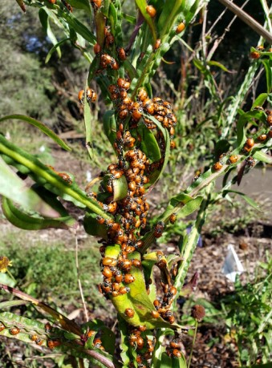
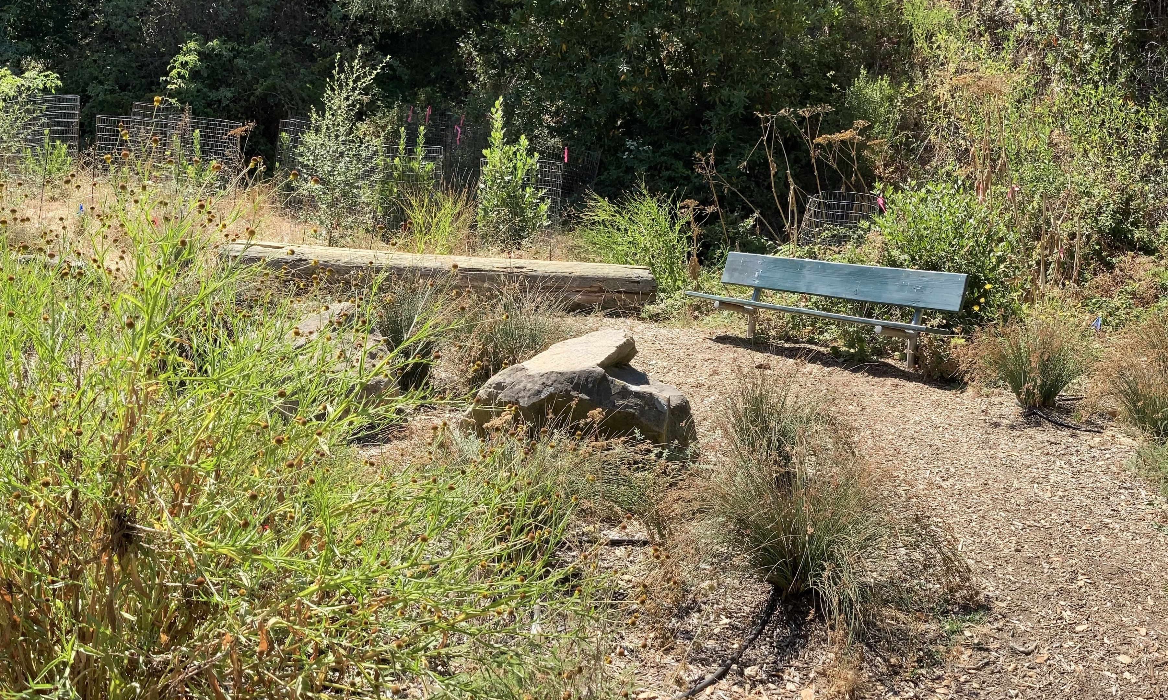
Overwintering lady bugs – 2019-2020

Slide 14
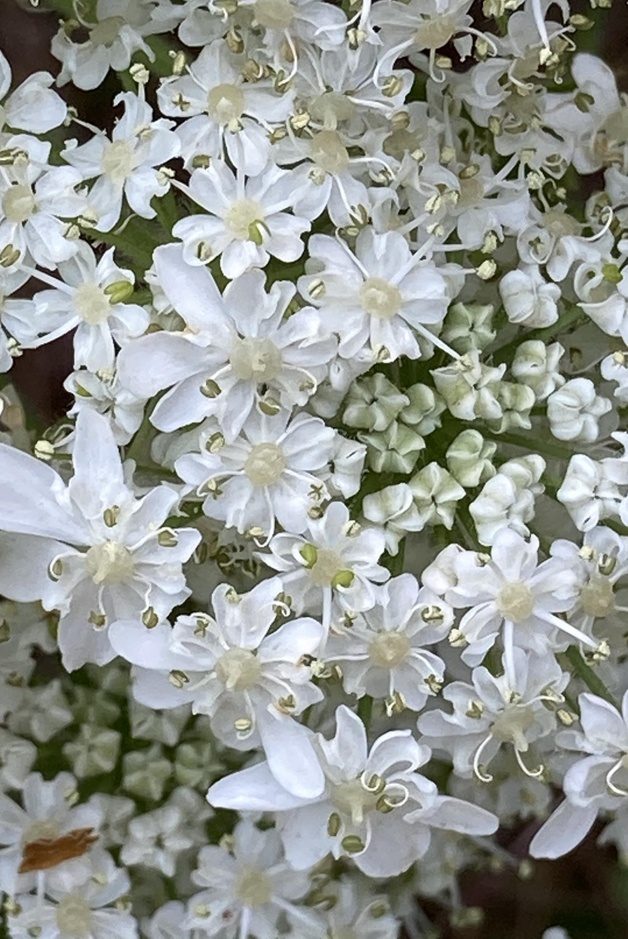
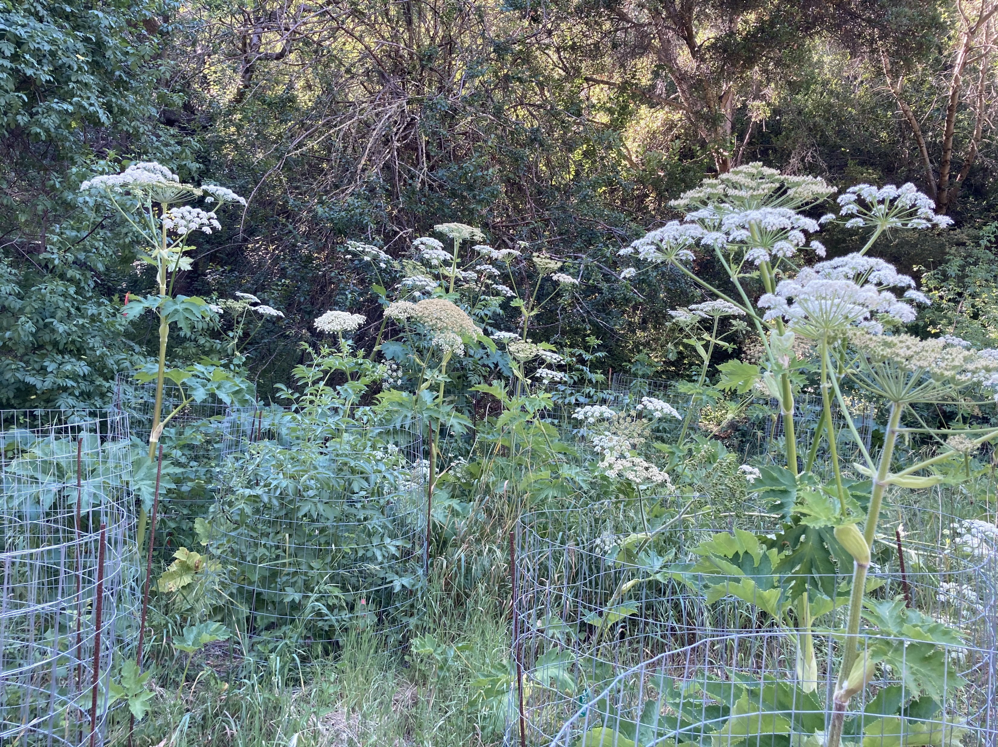
Cow parsnips (H. maximum) in bloom - May 2020

Slide 15
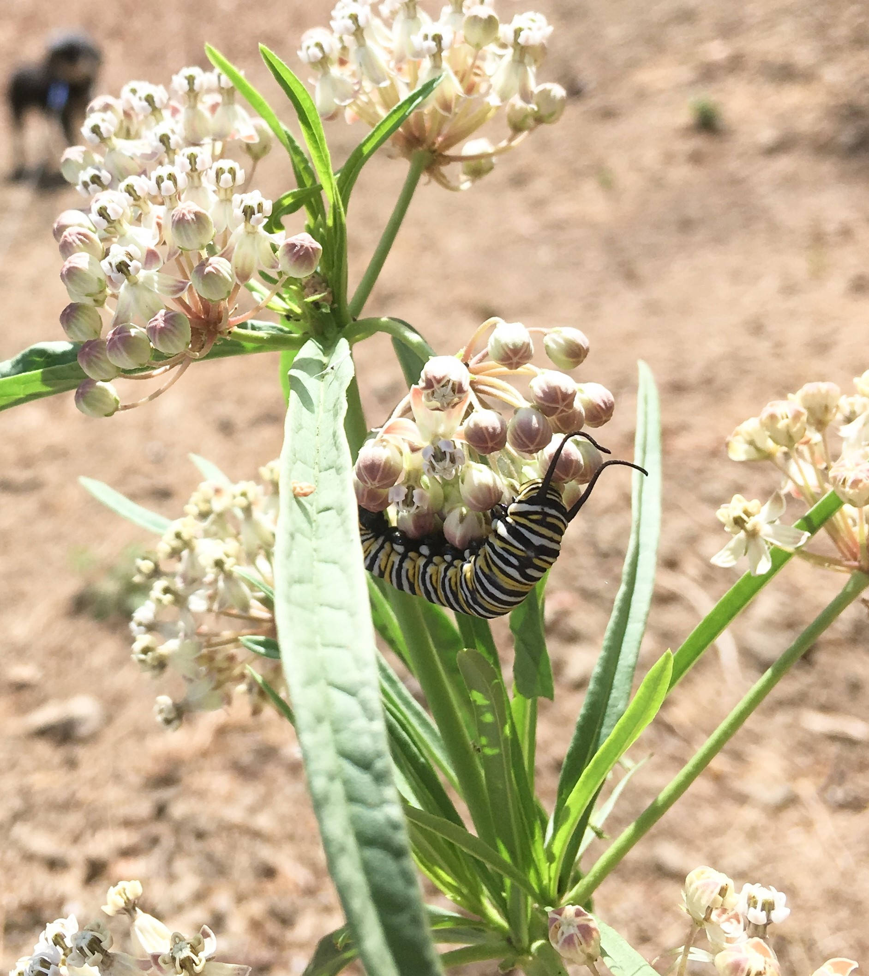
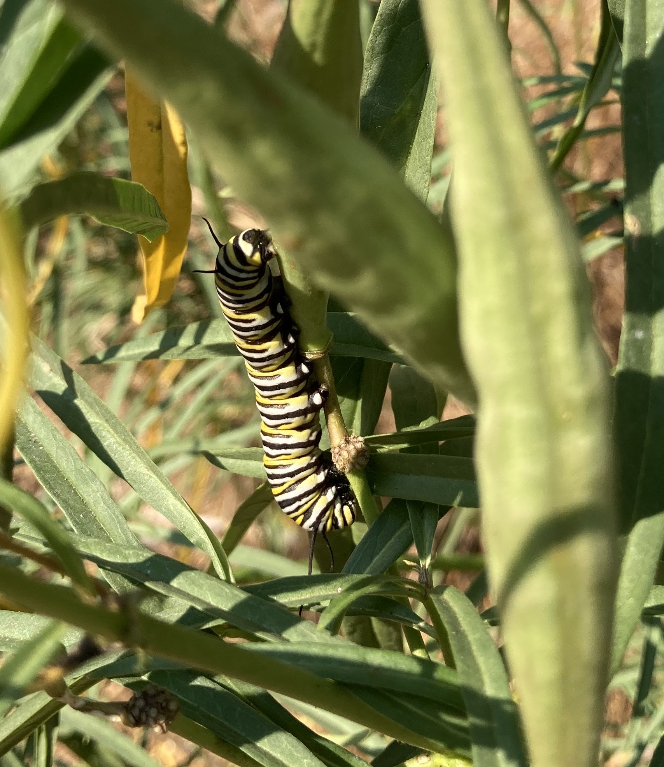
A return of the milkweed (A. fascicularis)
– and the monarchs!

Slide 16
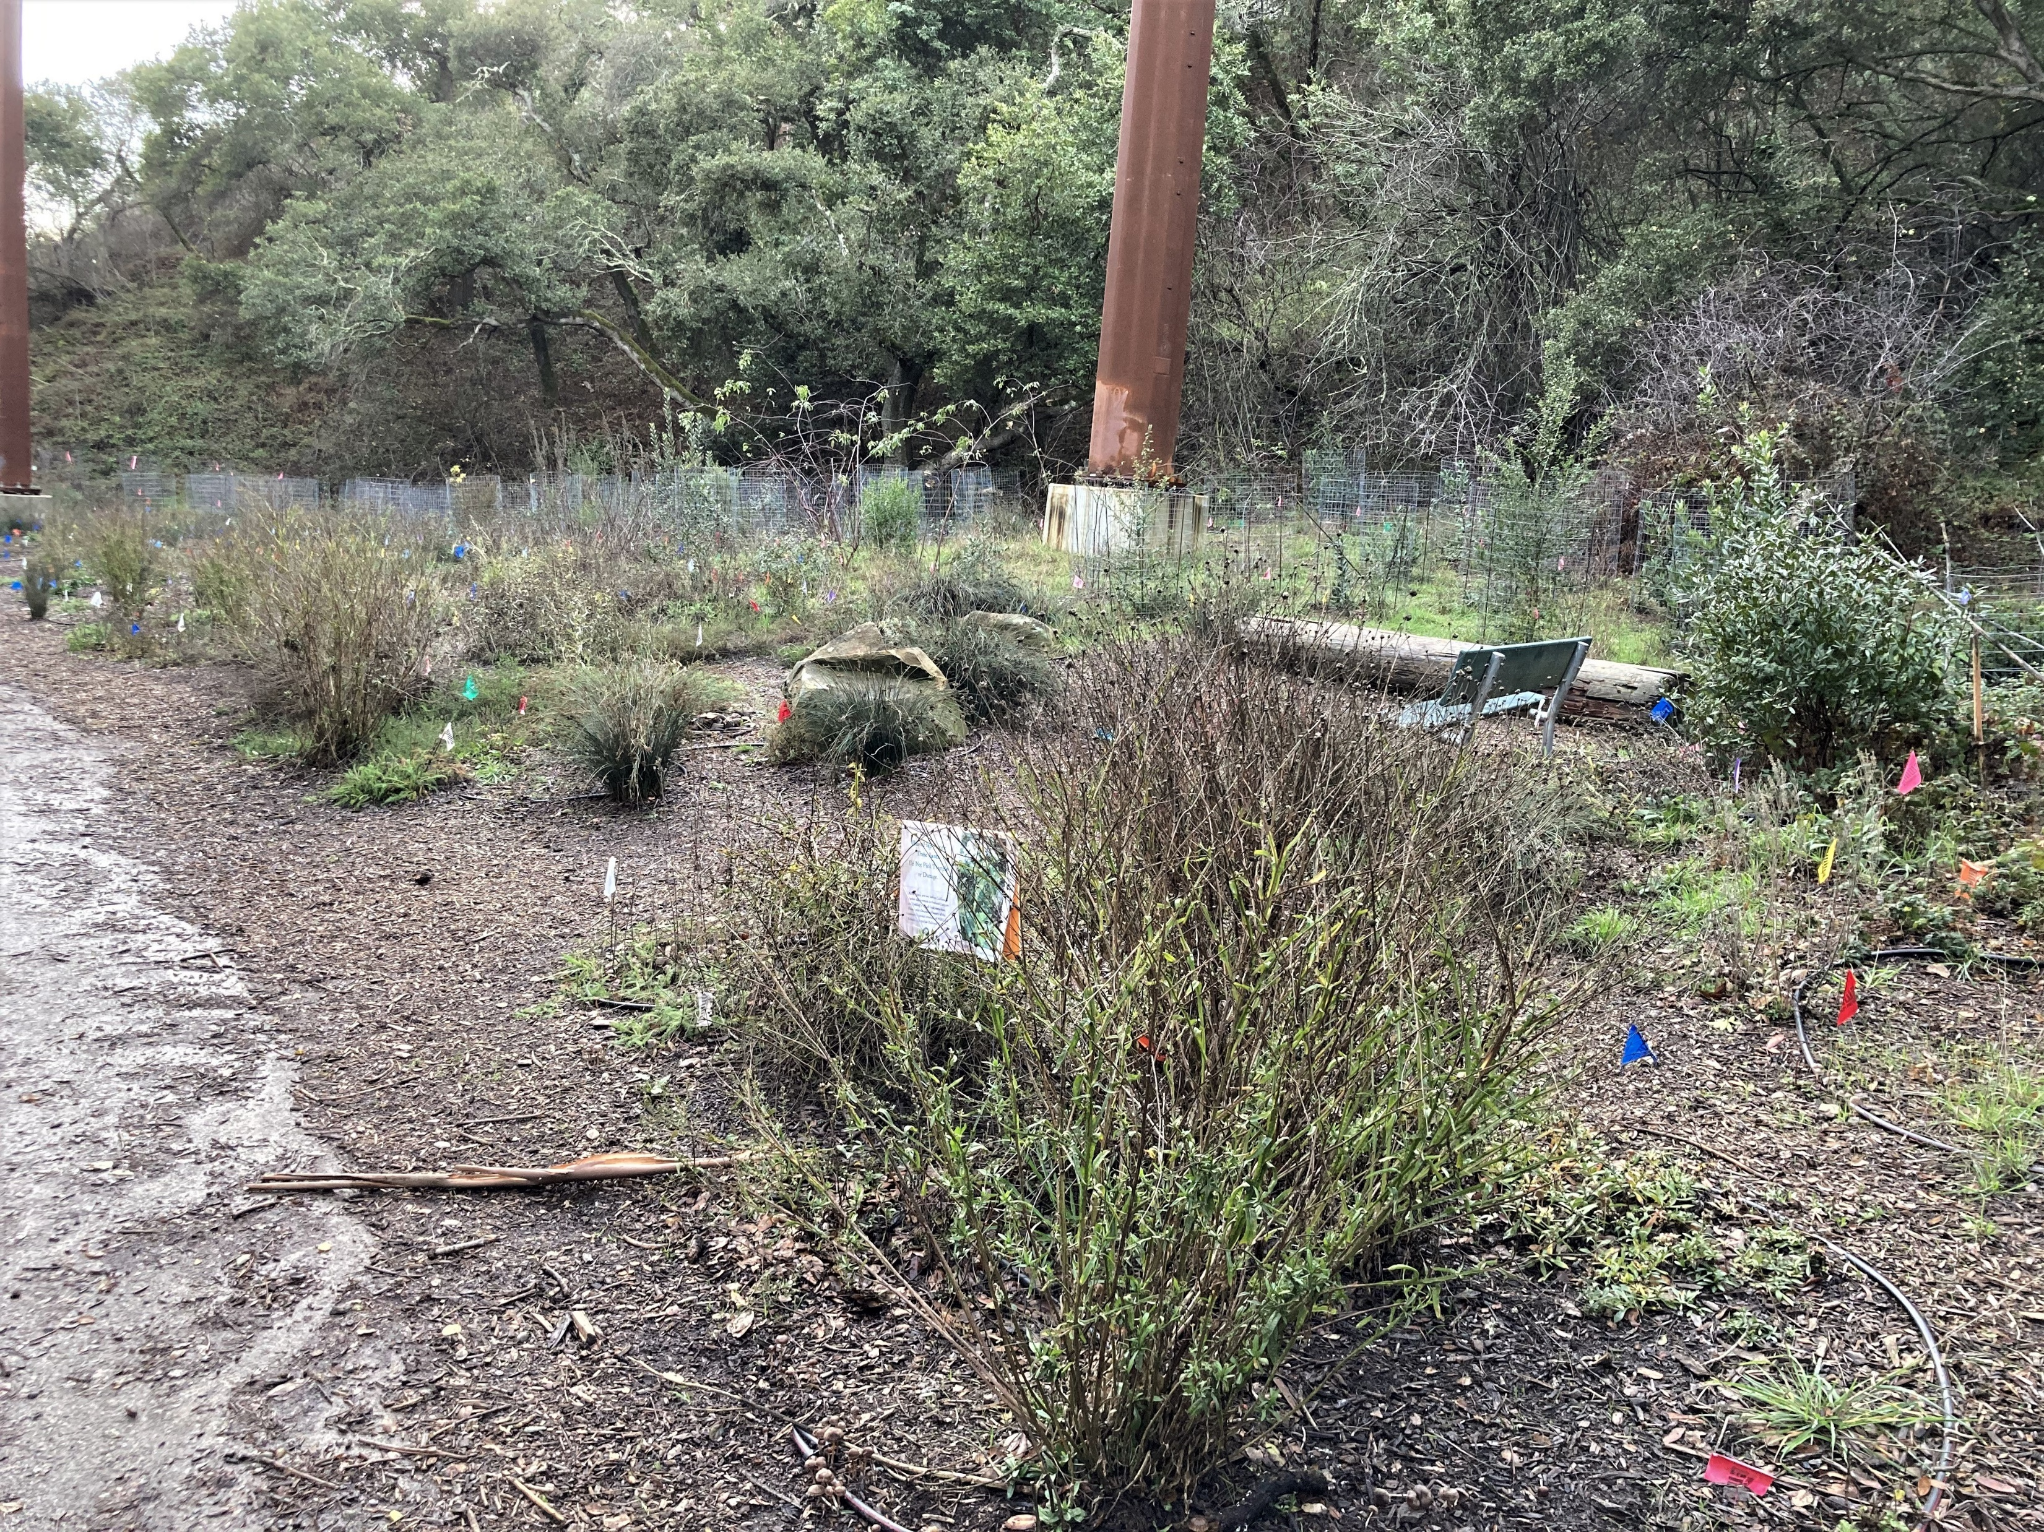
Late 2020 New signs of life are emerging all the time.

Slide 17
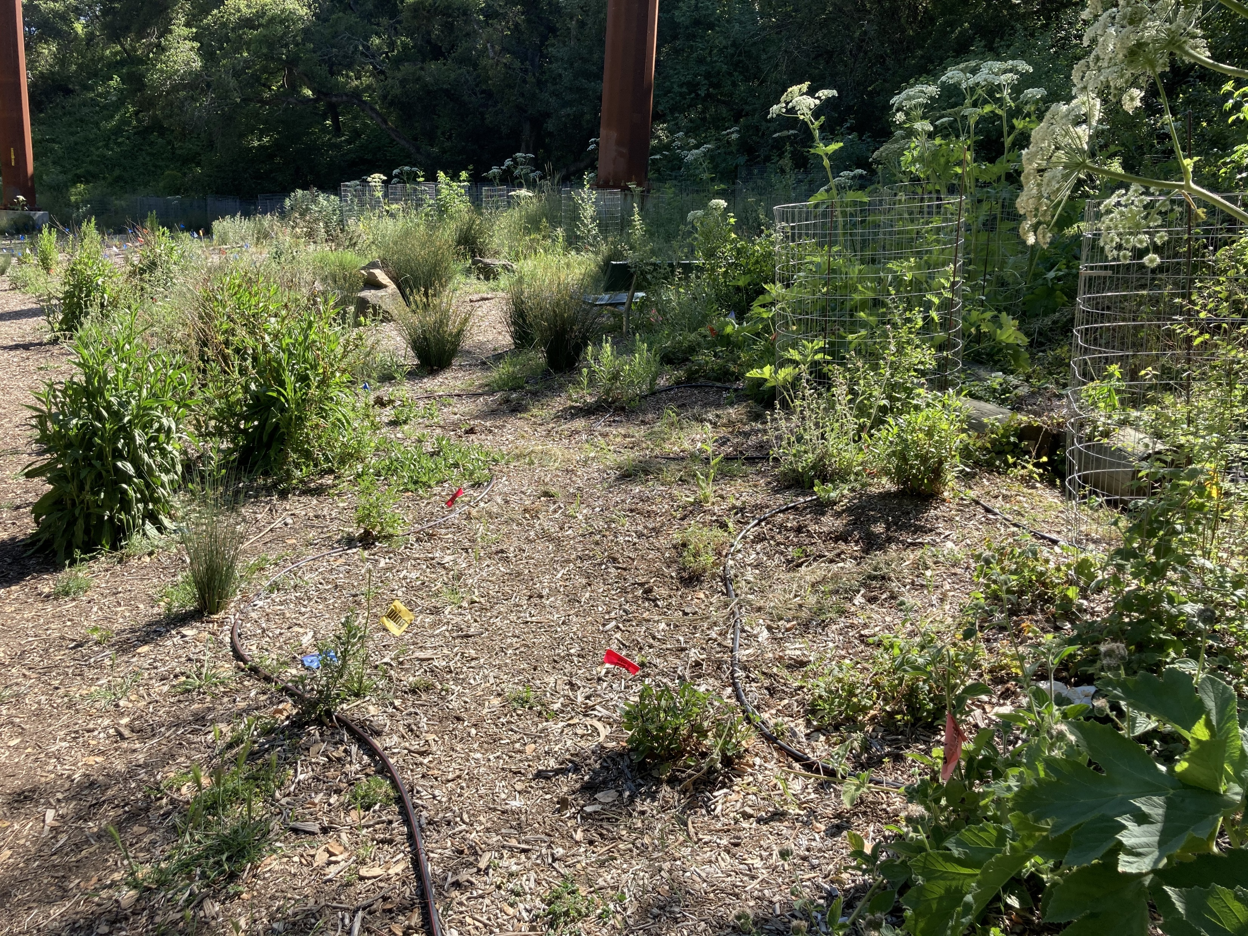
Another year to go, but the transformation is well underway. The new towers no longer seem to dominate the landscape. The east meadow is flourishing!

Slide 18
Friends of Montclair Railroad Trail
www.MontclairRRTrail.org

